Slide 1
Using Optimally Connected Pairs To Approximate TSP Solutions
Alexander J. Schmidbauer

Slide 2
Travelling Salesman Problem
"Given a list of cities and the distances between each pair of cities, what is the shortest possible route that visits each city exactly once and returns to the origin city?“
Complete Undirected Weighted Graph
Brute Force Required To Guarantee Optimal Solution
(n-1)! Calculations

Slide 3
Non Guaranteed Solutions
Do Not Guarantee Optimal Solution
May Be More Efficient
In Most Cases, Good Enough

Slide 4
Weighted Complete Undirected Graphs
Each edge is assigned a “distance” or “cost” value
Each node is connected to all other nodes by an edge
It costs the same to traverse an edge in one direction as the other

Slide 5
Smallest Edge Of A Node
Consider a Weighted Complete Undirected graph (WCU graph). If node k is in the WCU graph, of all the nodes connected to node k, the node min(k) is the closest to k; that is, the edge(k, min(k)) has the smallest weight of all the edges connected to node k. Every node within a WCU graph has one or more min(node).
Therefore, we define min(k) as the closest node to k.

Slide 6
Optimally Connected Pairs
In the case of a WCU graph, if there exists two nodes, a and b, where:
min(a)=b and min(b)=a
Then we define these nodes as an Optimally Connected Pair (OCP). An OCP contains two nodes, of which are closer to each other than any other nodes within the graph.

Slide 7
THEOREM
For every WCU graph, there exists at least one OCP comprised of nodes within the WCU graph.

Slide 8
PROOF
Proved using Proof By Contradiction

Slide 9
Consider a WCU graph G such that:
a. |G|= n
b. G = {g₁, g₂, g₃, …, g_{m,} g_{m+1}, …, g_{n-1}, g_{n}}
c. G has no OCP’s.

Slide 10
If there are no OCP’s in WCU graph G, then:
min(g₁) = g₂ min(g₂) = g₃ … min(g_{n-1}) = g_{n} min(g_{n}) = g_{m}
However, if the aforementioned is true, then:
|(g₁, g₂)| > |(g₂, g₃)| > … > |(g_{n-1}, g_{n})| > |(g_{n}, g_{m})| > |(g_{m}, g_{m+1})|

Slide 11
Simplified,
|(g_{m}, g_{m+1})| > |(g_{n}, g_{m})| > |(g_{m}, g_{m+1})|
(Not Possible)
So, a WCU cannot exist without an OCP.

Slide 12
OCP Algorithms
Take into account OCP’s to efficiently find paths in TSP Problems
Similar to Greedy Algorithms, but much more accurate
Extremely fast and cost efficient
Worst Case: n³ calculations
Best Case: n calculations
Average: 0.5n³ + 0.5n calculations
M² memory required

Slide 13
Tour of 50 USA LAndmarks
Originally covered by Newsweek in 1954
Challenge by Rand Corporation
50 Nodes, 6.08x10 ⁶² calculations to Brute Force
Believed to be Solved

Slide 14
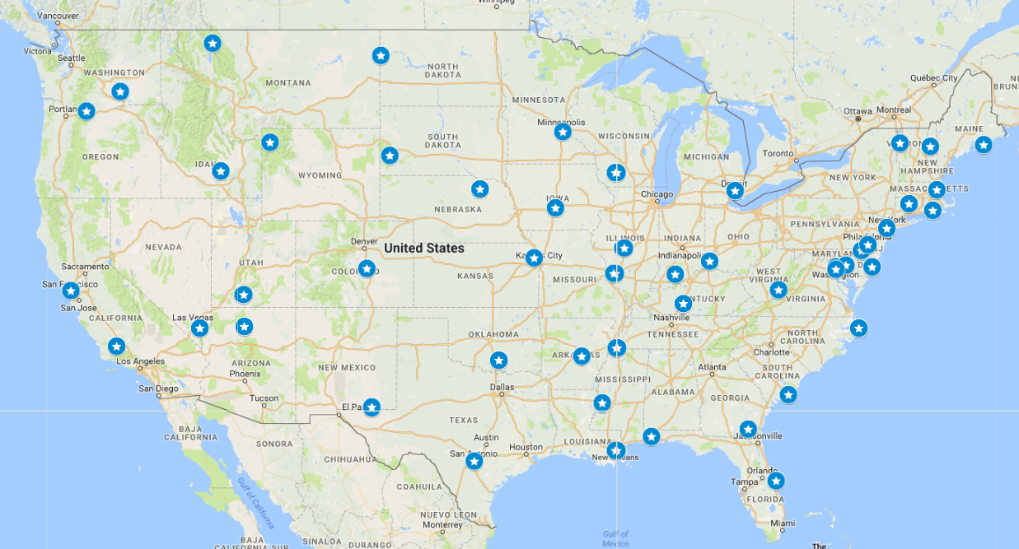
Data set

Slide 15
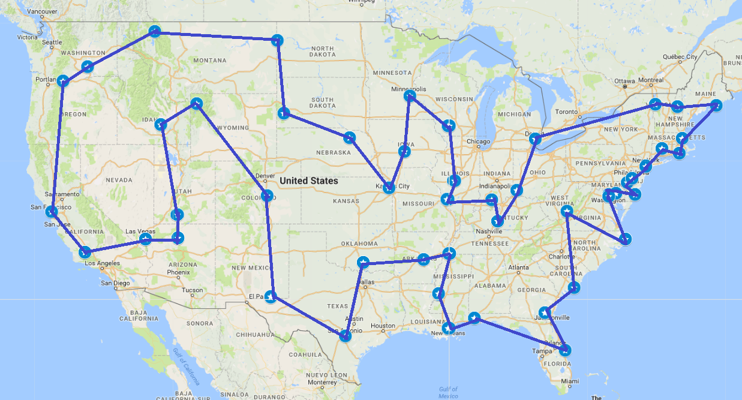
solution

Slide 16
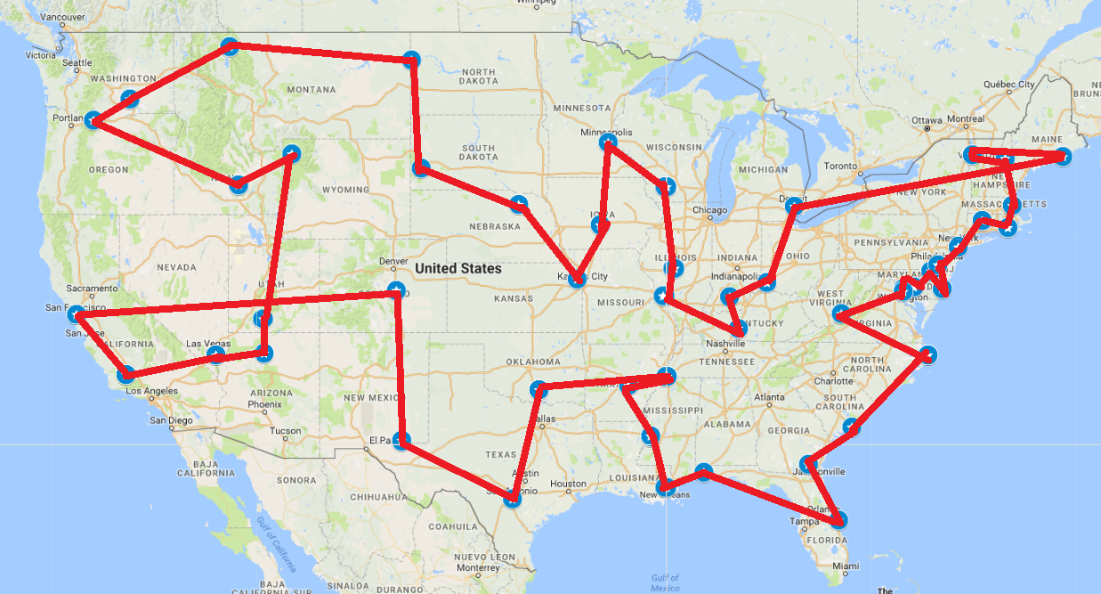
OCP Solution

Slide 17
OCP Algorithm 50USAL stats
~24500 Calculations Done By OCPA
OCP Solution Path 23696516 Miles
Real Solution Path 22015038 Miles
OCP within 7% of Real Solution!

Slide 18
Other Data sets
ID | Nodes | Calculations | Result | Optimal | How Close (Percent)
GR17 | 17 | 2176 | 2189 | 2085 | 4.751027867
FRI26 | 26 | 9100 | 960 | 937 | 2.395833333
XQF131 | 131 | 136240 | 664 | 564 | 15.06024096
XQG237 | 237 | 783048 | 1218 | 1019 | 16.33825944
PBM436 | 436 | 2655240 | 1740 | 1443 | 17.06896552
XQL662 | 662 | 6126148 | 2832 | 2513 | 11.26412429
DKG813 | 813 | 9242184 | 3669 | 3199 | 12.81002998
XIT1083 | 1083 | 16405284 | 4174 | 3558 | 14.75802587
DKA1376 | 1376 | 26488000 | 5544 | 4666 | 15.83694084

Slide 19
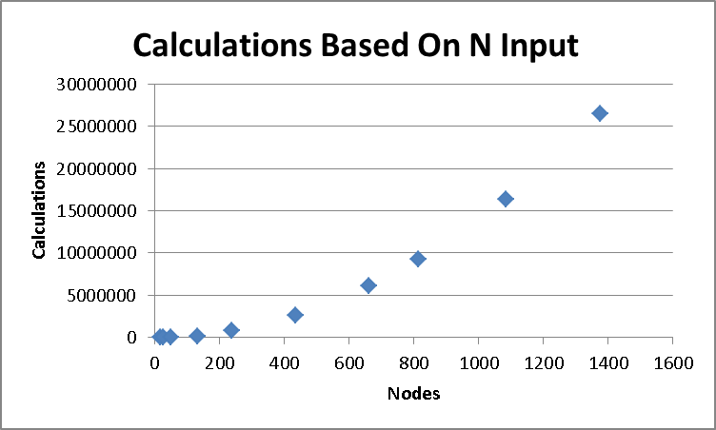

Slide 20
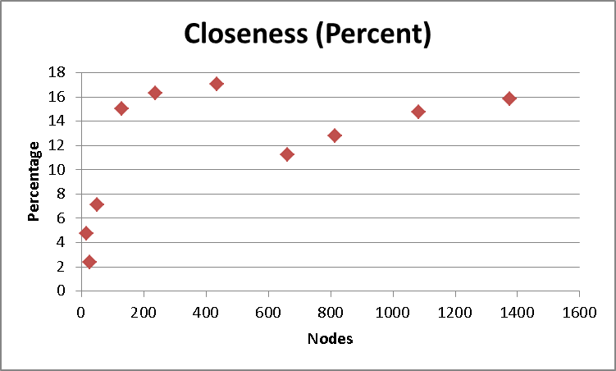

Slide 21
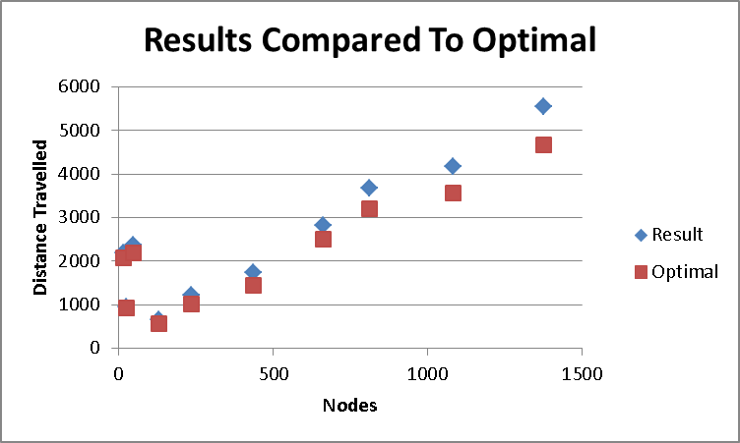

Slide 22
Results
OCP Algorithm Produces Very Efficient Solutions
OCP Algorithm Takes Very Little Calculations
OCP Algorithm is Competitive Against Other Algorithms

Slide 23
Works cited
http://www.math.uwaterloo.ca/tsp
https://people.sc.fsu.edu/~jburkardt/datasets/tsp/
https://www.iwr.uni-heidelberg.de/groups/comop
t/software/TSPLIB95/

